Slide 1

Basic Details of the Team and Problem Statement
Ministry/Organization Name/Student Innovation: Ministry of Mines
PS Code: SIH1339 Problem Statement Title: Automation of drill core rock sample lithology logging. Team Name: Achievers Team Leader Name: Abhishek Singh Maurya Institute Code (AISHE): U-0573 Institute Name: Indian Institute of Technology Kharagpur
Theme Name: Transportation & Logistics

Slide 2
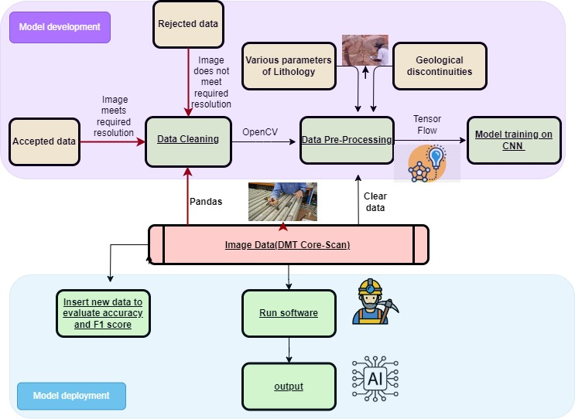
Idea/Approach Details
Describe your idea/Solution/Prototype here:
TECHNOLOGY STACK :
Programming Language: Python
Data Manipulation and Analysis: Pandas, NumPy, Collab/ Jupyter Notebook, OpenCV
Data Visualization: Matplotlib, Seaborn
Machine Learning Frameworks: TensorFlow, PyTorch, Scikit-learn
Frontend: HTML, CSS, JS
Backend: Django
Cloud: Azure

Slide 3
Idea/Approach Details
Describe your Use Cases here
Describe your Dependencies / Show stopper here

Slide 4
Team Member Details
Team Leader Name: Type Your Name Here
Branch (Btech/Mtech/PhD etc): Stream (ECE, CSE etc): Year (I,II,III,IV):
Team Member 1 Name: Type Your Name Here
Branch (Btech/Mtech/PhD etc): Stream (ECE, CSE etc): Year (I,II,III,IV):
Team Member 2 Name: Type Your Name Here
Branch (Btech/Mtech/PhD etc): Stream (ECE, CSE etc): Year (I,II,III,IV):
Team Member 3 Name: Type Your Name Here
Branch (Btech/Mtech/PhD etc): Stream (ECE, CSE etc): Year (I,II,III,IV):
Team Member 4 Name: Type Your Name Here
Branch (Btech/Mtech/PhD etc): Stream (ECE, CSE etc): Year (I,II,III,IV):
Team Member 5 Name: Type Your Name Here
Branch (Btech/Mtech/PhD etc): Stream (ECE, CSE etc): Year (I,II,III,IV):
Team Mentor 1 Name: Type Your Name Here
Category (Academic/Industry): Expertise (AI/ML/Blockchain etc): Domain Experience (in years):
Team Mentor 2 Name: Type Your Name Here
Category (Academic/Industry): Expertise (AI/ML/Blockchain etc): Domain Experience (in years):

Slide 5
Important Pointers
Please ensure below pointers are met while
Kindly keep the maximum slides limit to 4 pages
All the topics should be utilized for description of your idea
Try to avoid paragraphs and post your idea in points
Keep your explanation precisely and easy to understand
Idea should be unique and novel. If it has a business potential more weightage will be given.
Apart from this PPT abstract of your idea will be asked separately while submitting
You need to save the file in PDF and upload the same on portal. No PPT, Word Doc or any other format will be supported
You can delete this slide (Important Pointers) when you upload the details of your idea on SIH portal.

